Slide 1
Python Functions
DVT101 – Lecture 10
- By Dataverse Tutorials

Slide 2
Introduction
What is a Function?
Problem of repeated code
Real-life analogy
Benefits of using functions
Where functions are used in industry

Slide 3
What Exactly is a Function?
Block of reusable code
Performs a specific task
Defined once, used many times
Improves readability & maintenance
Input → Process → Output model

Slide 4

Defining a Function in Python
def keyword
Function name
Parentheses ()
Indented function body
Function definition vs execution

Slide 5
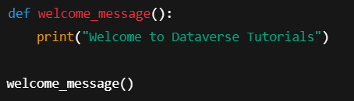
Calling a Function
Function call syntax
Execution flow
Memory behavior
Difference between define & call

Slide 6
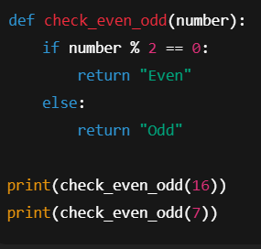
Function Arguments – Passing Data to Functions
Parameters vs Arguments
Data passing mechanism
Dynamic behavior of functions
Real-world examples

Slide 7
Types of Function Arguments
What are Function Arguments?
Why Different Argument Types are Needed
Default Arguments
Keyword Arguments
Positional Arguments
Arbitrary Arguments (*args, **kwargs)
Real-world usage of each type

Slide 8
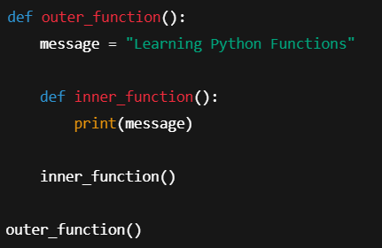
Nested Functions
Inner functions
Scope concept
Data protection
Clean architecture

Slide 9

Anonymous Functions – Lambda
No function name
One-line logic
Faster execution
Used in ML & Data Science

Slide 10
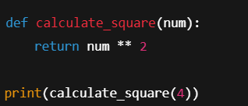
Return Statement
Ends function execution
Sends data back
Multiple returns
None return concept

Slide 11
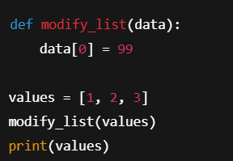
Pass by Reference vs Pass by Value
Mutable vs Immutable
Object reference model
Memory behavior

Slide 12
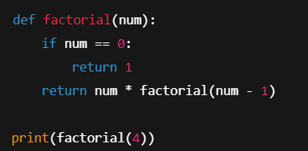
Recursive Functions
Function calling itself
Base condition
Stack execution
Mathematical problems

Slide 13
Real-World & Industry Use Cases
ML pipelines
Data preprocessing
API development
Automation scripts
Interview importance

Slide 14
Summary & Key Takeaways
Functions reduce repetition
Improve code quality
Mandatory for ML & DS
Foundation for OOP

Slide 15


